Slide 1
DEMO

Slide 2


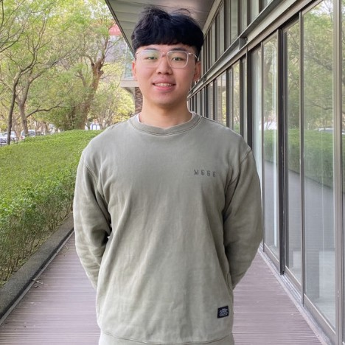


DB Events
Database
Web Server
Andrew
Web Cam
Raspberry Pi
Backend
Frontend
Arduino
Serial
Mac
Computer
Vision
Penny
Mechanism
Force Sensor
LED
Laser Cutting
3D Printing
Max
Yushan
Marshall

